Slide 1
Let Latency Be Gone! How NVMe, SCM and RDMA are tackling latency

Slide 2

PS C:\> $env:USERNAME Alex Bytes
Senior Infrastructure Specialist
Looks after ‘all the things’
Attempting to avoid going grey prematurely
Blogger of IT
ByteSizedAlex.com - Byte sized for when a nibble just isn't enough!
Twitter - @ByteSizedAlex

Slide 3
Get-Agenda
What is latency and why does it hurt performance?
How are technologies like NVMe, SCM and RDMA addressing this issue
Examples and study references throughout to give you an idea of the improvement you can realise through adoption
This isn’t a technical deep dive, the goal is to excite your interest in these technologies and get a feel for the results they can deliver

Slide 4
What is latency?
Generally: “A measure of the time delay experienced by a system”
Network specific: “A measure of the time delay required for information to travel across a network”
If you need to explain it to a non-technical person use the analogy of a phone call. The latency is the time taken for the other person to pick up and say hello after you start the call
For our discussion we are concerned with two types of latency:
Network latency
Storage latency
Whether it be to local disk or remote storage over a fabric
Network (fabric) latency will impact storage latency when we consider remote storage

Slide 5
Latency Impact
Online gamers will know the affects of latency well – it really hurts your K/D ☹ but you’re probably more interested in ‘business’ stuff
Amazon estimate 1% loss for every 100ms of latency
A study suggested 0.5 seconds additional latency on search page generation time dropped traffic by 20%
One report suggested a stock broker could lose $4 million in revenue per millisecond if their electronic trading system is 5 milliseconds behind the competition
Regardless of whether these are 100% accurate it is safe to say that latency hurts business. Those with high performing, lower latency platforms have a competitive edge.

Slide 6
How can we reduce latency and improve performance?
We will look at 3 technologies which can enable drastic reductions in latency
NVMe – Non-Volatile Memory Express
SCM – Storage Class Memory
RDMA – Remote Direct Memory Access
Not only is latency reduced but in the case of NVMe and RDMA so is CPU consumption
Lower latency, faster systems all with less CPU consumed, who wouldn’t want that!

Slide 7

What storage latency do you see in your environment?
> 10ms
5 <–> 10ms
1 <-> 5ms
< 1ms

Slide 8

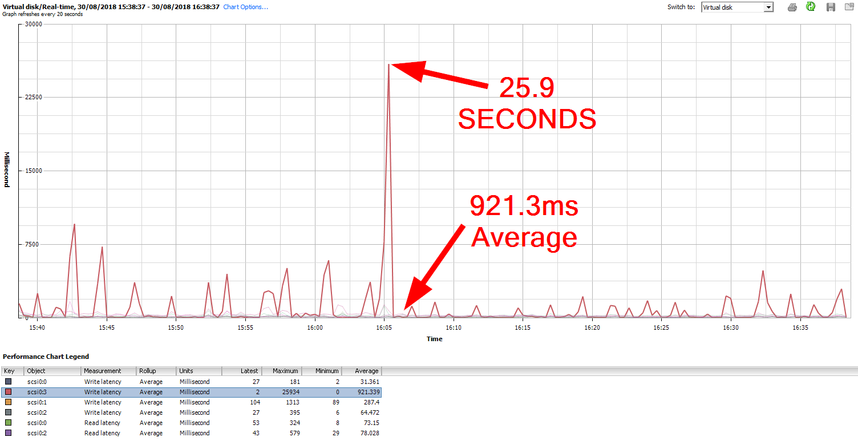
If you think your latency is bad…

Slide 9
NVMe – Non-Volatile Memory Express
A modern storage protocol built around PCIe connected SSD storage
Instruction set drastically reduced when compared to SCSI/AHCI
Simplified to remove a lot of the bloat in legacy protocols
Throughput scales with PCIe generation and lane count (1 –> 16 lanes)
NVMExpress.org describes it as such –
“NVM Express is a scalable host controller interface designed to address the needs of Enterprise and Client systems that utilize PCI Express based solid state drives. The interface provides optimized command submission and completion paths. Additionally, support has been added for many Enterprise capabilities like end-to-end data protection (compatible with SCSI Protection Information, commonly known as T10 DIF, and SNIA DIX standards), enhanced error reporting, and virtualization”

Slide 10
NVMe vs SAS & SATA
 | I/O Queues | Commands Per Queue | Bandwidth
SATA/AHCI | 1 | Up to 32 | 6Gbps
SAS | 1 | Up to 254 | 6 & 12Gbps
NVMe | 65,535 | 64,000 | PCIe Gen and Lane Dependent
Generation | x1 | x2 | x4 | x8 | x16
PCIe 3 | 1GB/s | 2GB/s | 4GB/s | 8GB/s | 16GB/s
PCIe 4 | 2GB/s | 4GB/s | 8GB/s | 16GB/s | 32GB/s
PCIe 5 | 4GB/s | 8GB/s | 16GB/s | 32GB/s | 64GB/s
PCIe lanes are bi-directional; Numbers are rounded theoretical for simplicity
PCI-SIG is targeting Q1 2019 for completion of the PCIe 5.0 specification

Slide 11
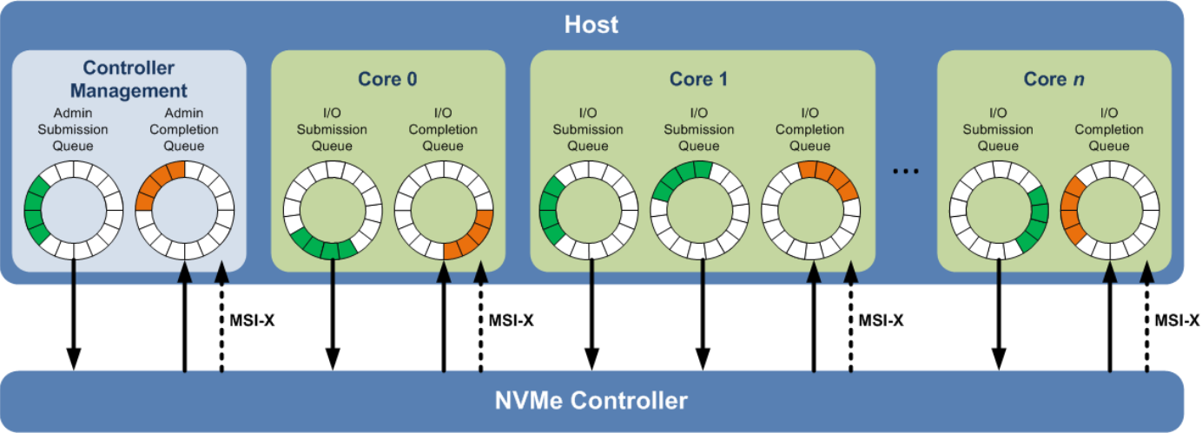
NVMe Queues
Each CPU core can host a submission/completion queue pair for each NVMe device (queue count is controller specific)
Message Signaled Interrupts leveraged (software interrupt as opposed to dedicated circuit/trace)
Reference: SNIA - The Performance Impact of NVM Express and NVM Express over Fabrics

Slide 12
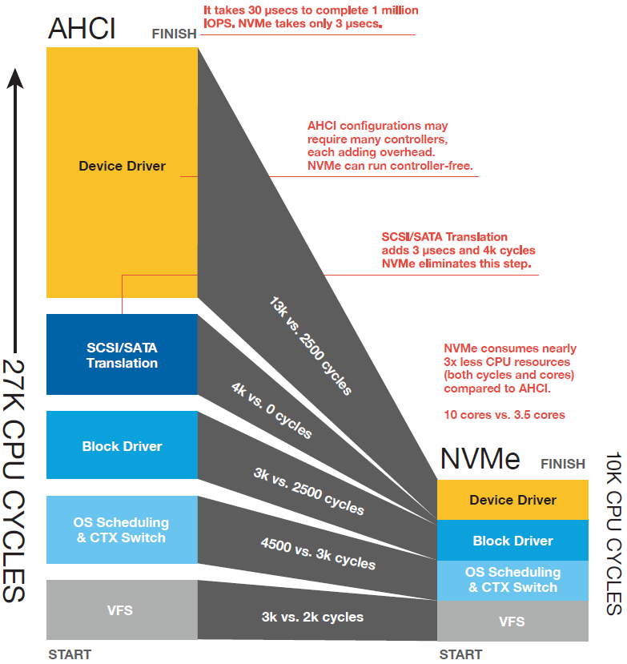
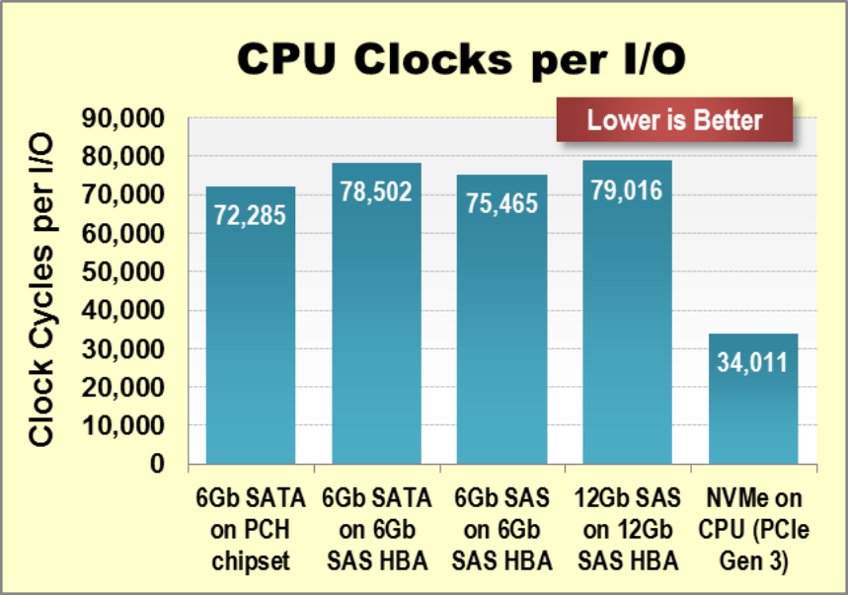
CPU Cycle Reduction
References: nvmexpress.org - NVMe Overview
NVMe—Performance for the SSD Age - Seagate
Numbers vary but typically claimed
to half the cycles required to process an IO

Slide 13
SCM – Storage Class Memory
PCIe is still slow compared to the memory bus – directly attach persistent storage to the main memory bus (currently DDR4)!
Persistent storage at close to RAM latencies (nanoseconds)
PMEM – Persistent Memory
NVDIMMs
NVDIMM-N - DRAM backed by flash memory
NVDIMM-F – Flash on DIMM module
NVDIMM-P – Multi-function
Intel 3DXPoint Optane
Devices can operate in either classical ‘Block Addressable’ mode or in DAX (Direct Access) mode where they are treated as ‘Byte Addressable’ memory devices

Slide 14
NVDIMM Performance
HPE example using 8GB NVDIMM module in block addressable mode (note that DAX mode results would be even better)
Micron demonstrate the difference between Block and DAX performance
Reference: HPE Persistent Memory for HPE ProLiant Servers
Parameter | NVDIMM vs SAS SSD | NVDIMM vs PCIe Accelerator
IOPS | 34x Increase | 24x Increase
Bandwidth | 16x Increase | 6x Increase
Latency | 81x Lower | 73x Lower
Storage | IOPs | Delta (vs SSD) | MB/s | Latency (ns)
NVMe SSD | 14,553 | Baseline | 56.85 | 66,632
Block NVDIMM-N | 148,566 | 10.2X | 580.34 | 6418
DAX NVDIMM-N | 1,112,006 | 76.4X | 4343.78 | 828

Slide 15
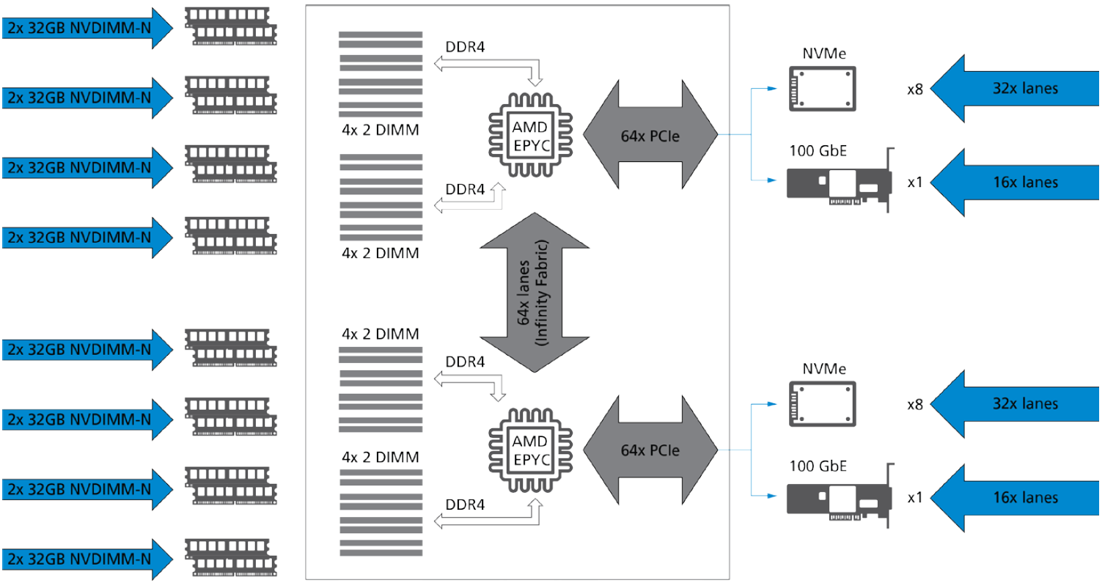
“If each 32GB NVDIMM-N is capable of around 1.1 million IOPS; Using 16x 32GB NVDIMM-Ns in our example, we have the potential to reach 17 million IOPS in the NVDIMM-N layer alone. When added to the 16 NVMe SSD using 11TB Micron 9200 SSDs (800,000 read IOPS per SSD), we can produce an additional 9.6 million IOPs at the NVMe layer. The combined NVDIMM-N and NVMe IOPS exceed 26 million in 2RU! Real-world performance is, of course, application, workload and file system dependent.”
Reference: AMD’s EPYC Architecture Benefits Storage-Centric Solutions

Slide 16
SCM Usage Examples
Microsoft support the use of SCM in Storage Spaces Direct (S2D) to accelerate the write caching tier
Combined with SMB Direct/MultiChannel (their buzz word for RDMA) to enable low latency between nodes you can get really good performance
SQL server can use SCM either as a block addressable device or via DAX mode for Tail of Log Writes (ToLW)
Dell provide an example using SCM for ToLW –
Increase of roughly 42% in Transactions Per-Second
Increase of roughly 43% in Batch Requests Per-Second
3PAR Storage platforms offer SCM as a caching layer – 50% latency reduction, 80% increased IOPS according to HPE blog

Slide 17
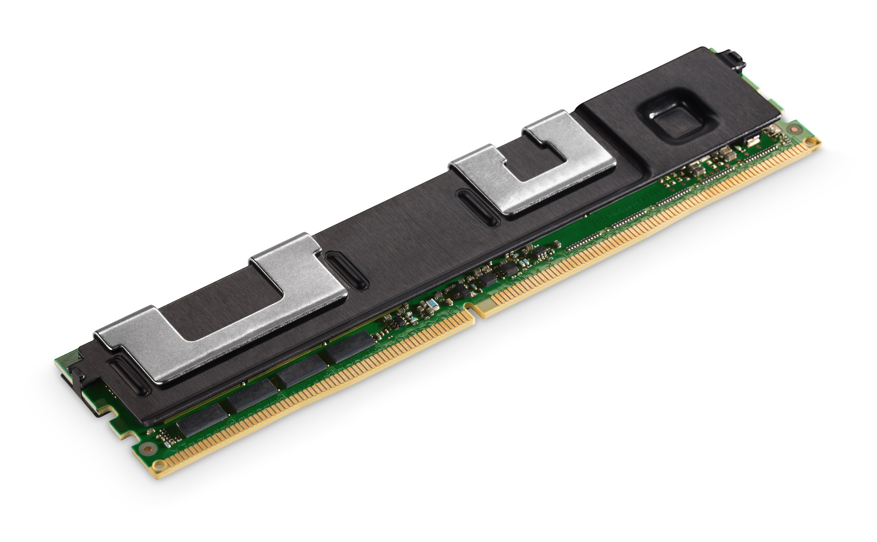
Intel Optane DC Persistent Memory
As the name suggests, it’s persistent
Intel indicated DRAM ‘like’ speeds – until publically available we can’t put a value to this (Intel state ‘broad availability’ 2019)
No Power Loss Protection (PLP) required unlike NVDIMM
Capacities per module –
128GB
256GB
512GB
With these capacities you could feasibly deploy ~6TB PMEM in a dual socket system alongside ~1.5TB RAM (3TB RAM if using M series Xeon)
Scalable Xeon supports 2 DPC, DRAM and Optane can be deployed in tandem
6 x 512GB Optane per Socket
6 x 128GB DDR4 per Socket

Slide 18


RDMA – Remote Direct Memory Access
Not a new technology but being adopted in Enterprise. Many hyperscalers and cloud providers run Ethernet based RDMA
Ethernet based RDMA is offered in two competing flavours
iWARP – Internet Wide Area Remote Direct Memory Access Protocol
RoCE (v1 and v2) – Remote Direct Memory Access Over Converged Ethernet

Slide 19
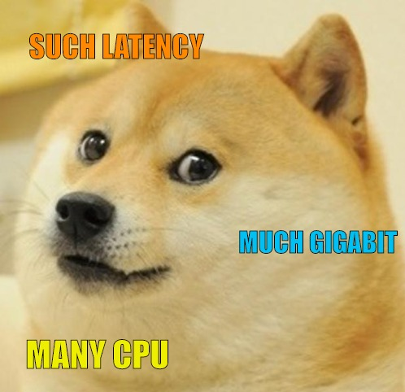
Why RDMA?
Massive reduction in CPU overhead when processing network traffic
Increased throughput (more gigabits per second)
Huge reduction in latency

Slide 20
What is DMA?
Implemented to free CPU from data movement –CPU time is lost doing data move on slower buses/context switching
Classically a discrete microcontroller was added to a system to facilitate DMA
Known as a DMA Controller (DMAC)
In time this was moved into the PCH (Platform Controller Hub) and then into individual devices which ran their own
Types of DMA:
Device to Device
Device to Memory
Memory to Memory

Slide 21
Traditional TCP Communication
Note the many Buffer-To-Buffer copies – requires CPU processing time and incurs latency

Slide 22
RDMA Enabled Copy
Buffer copying eliminated – direct transfer from Application memory space through RDMA enabled NIC to destination Application memory space

Slide 23
Microsoft Finding…
Microsoft provide an example of network traffic CPU consumption:
2 Cores Consumed on 10Gb Ethernet
8 Cores Consumed on 40Gb Ethernet
RDMA virtually eliminates this overhead which is vital for performance scaling and ensures CPU cores are doing actual ‘work’
Microsoft already support 10, 40, 50 and 100Gb Ethernet
400Gb and 1Tb are in testing – RDMA will be critical in ensuring CPU cores are not saturated at these speeds
How many cores do you think could be lost at those speeds?
RDMA will (I believe) in time become another ‘standard’ offload we expect on NICs
(Once the whole VHS/Betamax war between iWARP and ROCE is over)
Reference: Microsoft - Deep dive on Windows Server 2019 updates

Slide 24
Microsoft RDMA vs TCP/IP
Metric | RDMA | TCP/IP | RDMA Advantage
IOPs | 185,500 | 145,500 | 40,000 additional IOPS with the same workload
IOPs/%kernel CPU | 16,300 | 12,800 | 3500 additional IOPs per-percent CPU consumed
90th Percentile Write Latency | 250µs | 390µs | 140µs (~36%)
90th Percentile Read Latency | 260µs | 360µs | 100µs (28%)
Reference: Microsoft - To RDMA, or not to RDMA – that is the question

Slide 25
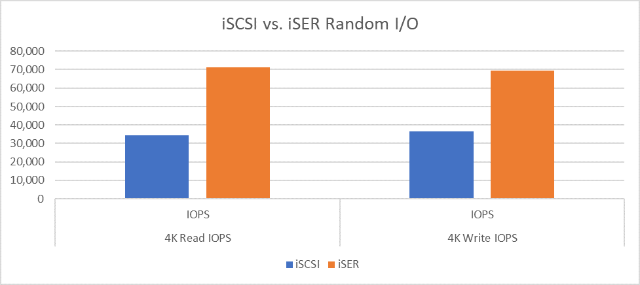
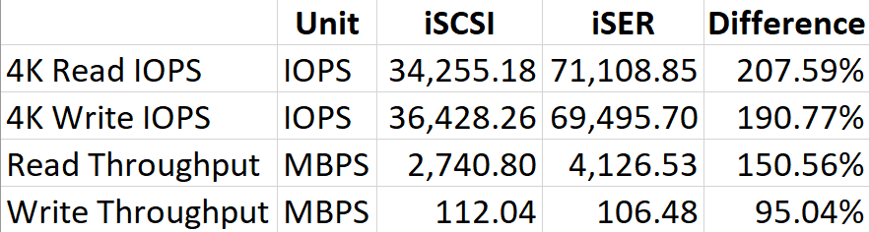
VMware - iSER (iSCSI Extensions for RDMA)
Using a pretty ‘low performance’ setup (ZFS with 4 x mirror set with 8 x 450 GB SAS drive (RAID 10) – no flash media or other storage acceleration

Slide 26
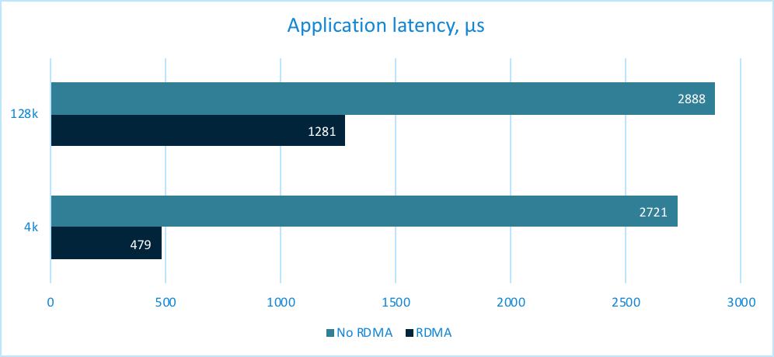
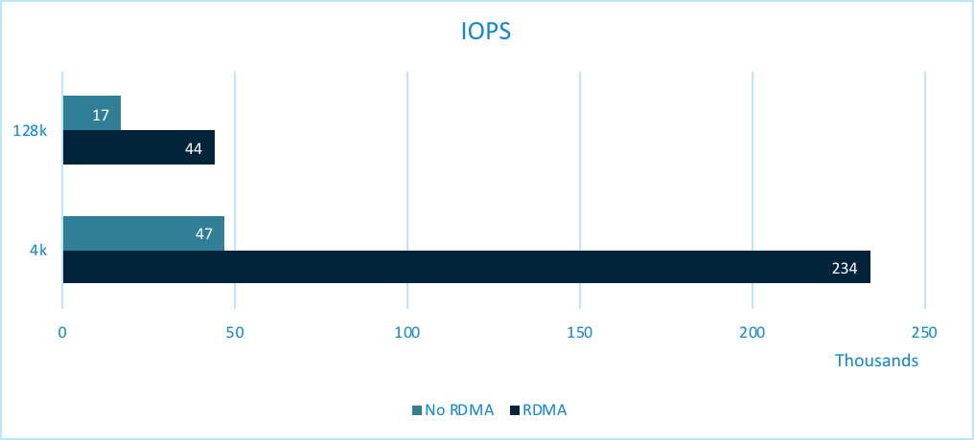
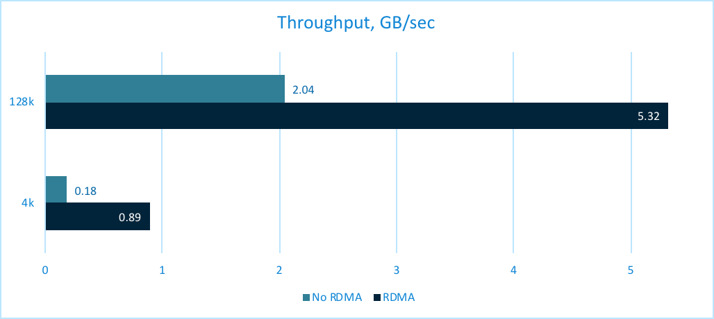
Mellanox RDMA Study – 50Gb NIC NFS
Reference: Mellanox - Boosting Performance With RDMA – A Case Study
5.32GBps roughly equals 42.5Gbps

Slide 27
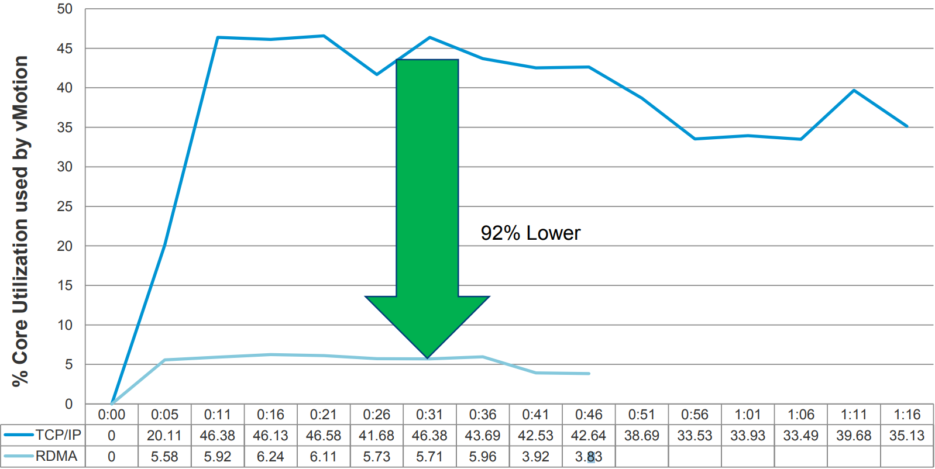
VMware vMotion CPU Utilisation
Source CPU Utilisation: 84% Lower
Destination CPU Utilisation: 92% Lower
Reference: Open Fabrics Alliance - RDMA on vSphere: Update and Future Directions

Slide 28

NVMe & RDMA?
To get the best of both worlds we can access NVMe storage over an RDMA fabric
NVMe over Fabrics (NVMeoF) – e.g either over Fiber Channel (FC) or RDMA Ethernet
Future fabrics expected to be supported (e.g GenZ)
NVMe over Fabrics goal is to provide connectivity to remote NVMe devices with no more than 10 microseconds additional latency over a local NVMe device

Slide 29

Balanced System Design
Designing a balanced system is important to ensure each component can perform at its best without being bottlenecked too much by others
Consider that high speed I/O (network, storage) requires large numbers of PCIe lanes
100Gb Ethernet – 1 port requires PCIe Gen3 x16 lanes (12.5GB/s)
Dual port card would require 25GB/s which exceeds Gen3 capacity
Evenly distribute devices across CPU sockets
We want to minimise socket <-> socket traffic so ensure fabric connectivity and local storage exists across both

Slide 30
Takeaway
SCM devices bring persistent storage to the memory bus resulting in greater IOPs, throughput and significantly lower latency (potentially nanoseconds)
NVMe enables far greater performance scaling with substantial latency reductions compared to traditional SAS/SATA
RDMA enables efficient network transfer while also reducing latency to levels close to local access. CPU cycles are freed to do real work, not moving packets!

Slide 31

Questions

Slide 32

Feedback
Feedback is truly valued; either directly or via the team at TechUG
Slides available: ByteSizedAlex.com

